Slide 1
PERFORMING ARTS
DANCE

Slide 2
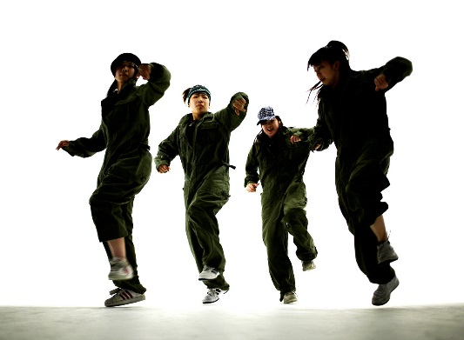
Lesson Objective
Participate in an effective warm up showing focus, energy and determination.
Identify areas of strength and improvement
Continue to learn the street dance routine that the uses the 5 basic actions

Slide 3
Success Criteria
Level | Dance Strand
 | 1 Creating | 2 Performing | 3 Reflecting
Entry | I can remember a range of actions I can create phrases based on a stimulus or music | I can participate in a short group performance I show some consideration of spatial awareness in performance | I can recognise when my own work and the work of others’, could be improved
1 | I can perform simple dance phrase demonstrating choreographic skills | I can use appropriate characterisation in a performance | I can talk about why I made certain decisions in my choreography I can show a basic understanding of how a stimuli can be conveyed
2 | I can create a choreography using unison and cannon I can learn teacher led sequences and then use these to develop my own levels I can create a choreography using a range of stimuli I can take on feedback to improve my choreography such as using levels and/or contract work I can sustain a focus within a performance | I can learn a routine and take part in simple performances | I can give suggestions on how work could be improved I can talk about my work using some dance terminology I can identify strengths and weaknesses in my own and others work
3 | I can select and apply movement to match the given dance style I can work confidently in a group using a range of choreographic devices to explore different dance styles and ideas I can create and rehearse performance that make use of the range of techniques and dynamics to express my ideas I can give and accept suggestions to/from peers and teachers during the rehearsal process I can learn and create dances in a variety of styles | I experiment with different actions to create a performance I can create routines that are appropriate to the given style or stimuli I can experiment with different styles/actions and dynamics when developing a routine I improve and refine my performance through the rehearsal process I can choreograph a short performance for an audience I can perform a variety of different dance styles | I can reflect on and evaluate my own and other pupils’ work, suggesting improvements I can use key words when talking about dances that I have seen or participated in I can discuss the ways that ideas are communicated

Slide 4
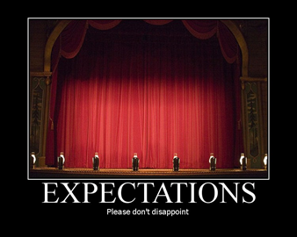

RECAP OF EXPECTATIONS
BE RESPECTFUL OF OTHERS IN THE CLASS.
TRY YOUR HARDEST AT ALL TIMES.
LISTEN TO FEEDBACK AND USE THIS CONSTRUCTIVELY TO IMPROVE YOUR PERFORMANCE.
LISTEN TO THE TEACHER AT ALL TIMES.
BE ABLE TO WORK AS A GROUP AND INDEPENDENTLY.
BE CREATIVE.
USE THE STAGE EFFECTIVELY.
LISTEN TO YOUR PEERS IDEAS

Slide 5
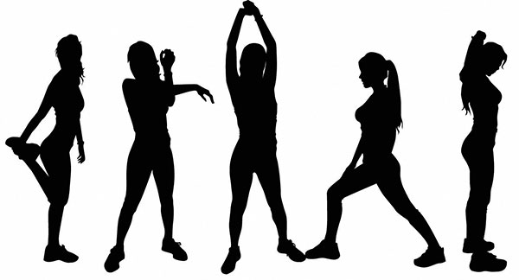
PUPIL LEAD WARM UP
RECAP YOUR WARM UPS IN YOUR GROUPS FROM LAST WEEK AND BE READY TO TEACH THEM IN 3 MINUTES.

Slide 6
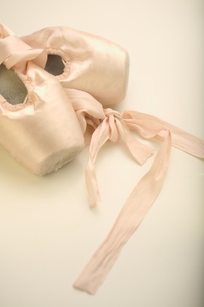
KEY WORDS
DYNAMICS
MUSICALITY
FOCUS
EXTENSIONS
PERFORMANCE SKILLS

Slide 7

STREET DANCE
In the routine you now need to focus on your execution of movements. What does this mean? Discuss
Recap sections 1, 2 and 3 of your street dance routine.

Slide 8
STREET DANCE
In groups of 4 you are going to create a small section of your own to add onto the street dance routine.
You need to create 2x8 counts. Thinking about levels and dynamics.

Slide 9

PEER ASSESSMENT TIME
WITH THE GROUP YOU HAVE BEEN WORKING WITH PAIR UP WITH ANOTHER GROUP AND YOU ARE GOING PERFORM TO EACH OTHER.
PEER ASSESSMENT
SET THE GROUP INDIVIDUAL TARGETS ON HOW THEY CAN IMPROVE THEIR PERFORMANCE..

Slide 10
PLENARY
What have you learnt today?
What are your targets?
What does musicality mean?
What does dynamics mean?
What does extensions mean?
Each corner of the room is a level. Go to the corner you think you are at and be ready to explain why and how you could improve.

